Slide 1







SIMPLIFYNEXT X UIPATH RPA
Deliver
and Send
Presented by: Radiance

Slide 2



Team Radiance
Lee Kar Jun Lester
Zheng Rong Tao
Lee Chen Wei

Slide 3


Topic Outline
1
Introduction
4
Business Application
2
Problem Statement
5
Other Applications
3
Solution
6
Q&A

Slide 4

Introduction
Automation services administratives for parcel Deliveries
Rise of E-Commerce
Accounted for 22% of Sales amounting to $3.3 trillion in 2022
159 Billion Parcel Shipped worldwide
200 Thousand Parcel Delivery Daily in Singapore
Revenue of Singapore eCommerce market is projected to reach US$6.59bn in 2023.

Slide 5
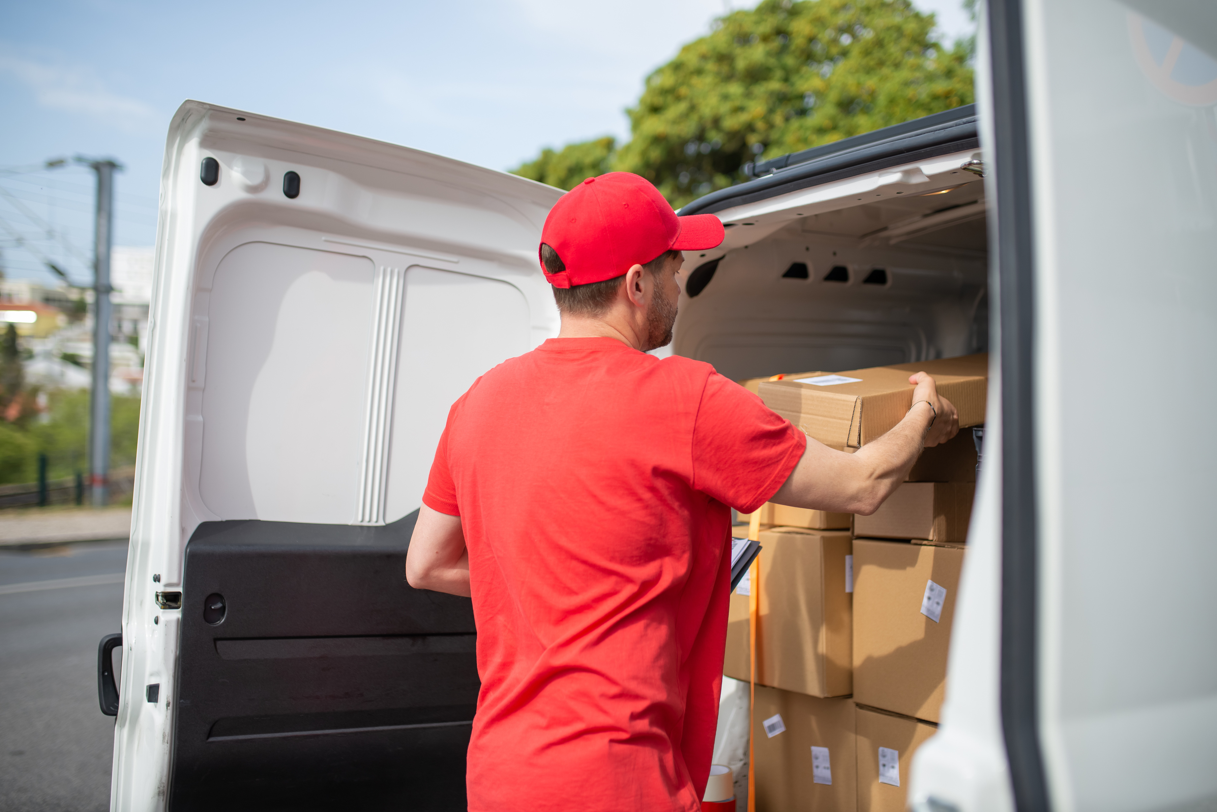

Problem Statement
How can we streamline delivery process which is manual dependent?
Surge of orders in Covid Times leads to logistical nightmare for local firms resulting in lost parcels.
Bad Customer Experience
Conflicts in Buyer and Seller

Slide 6
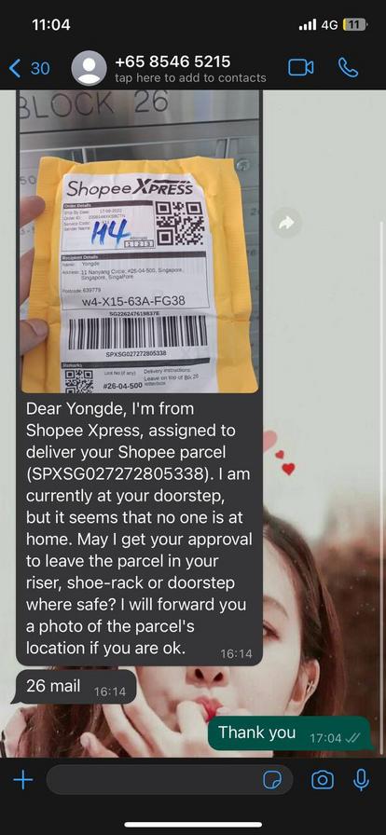
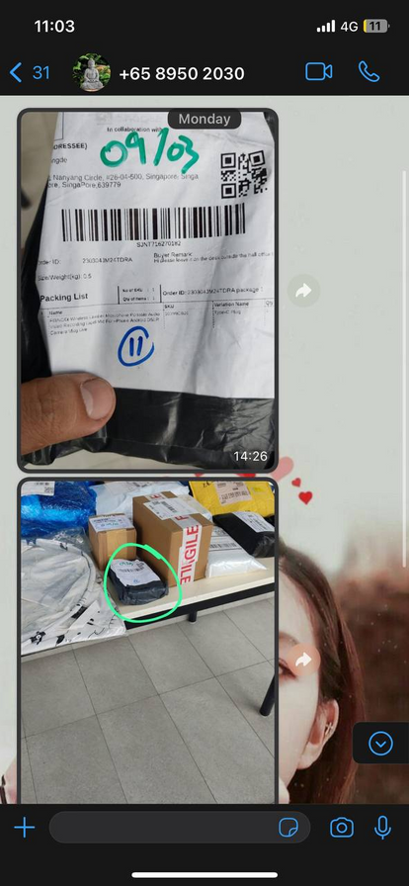
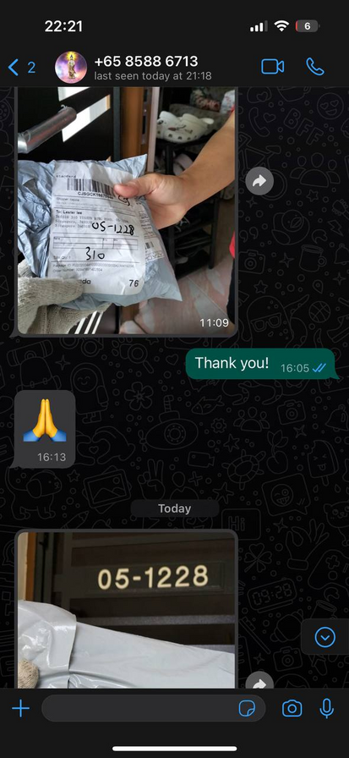
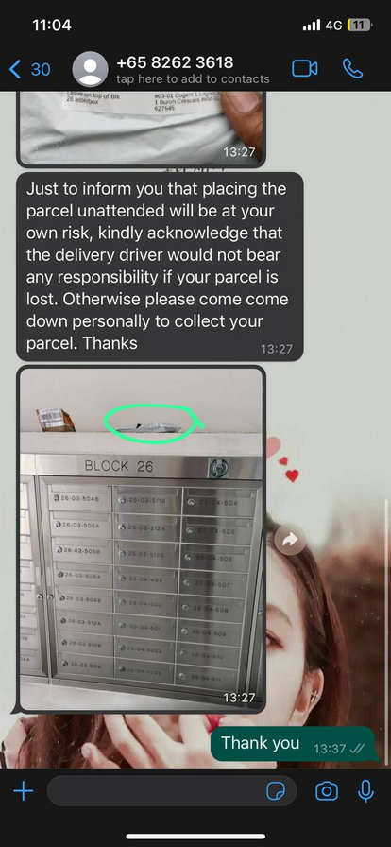
The Problem

Slide 7

Our Solution
1
Verification of location
Delivery Drivers will be assured that they are at the right address via geotagging
2
Automated Notification
Buyers will receive a text and photo notification when parcel has arrived.
Photo of Parcel will be recorded in our database for confirmation.

Slide 8
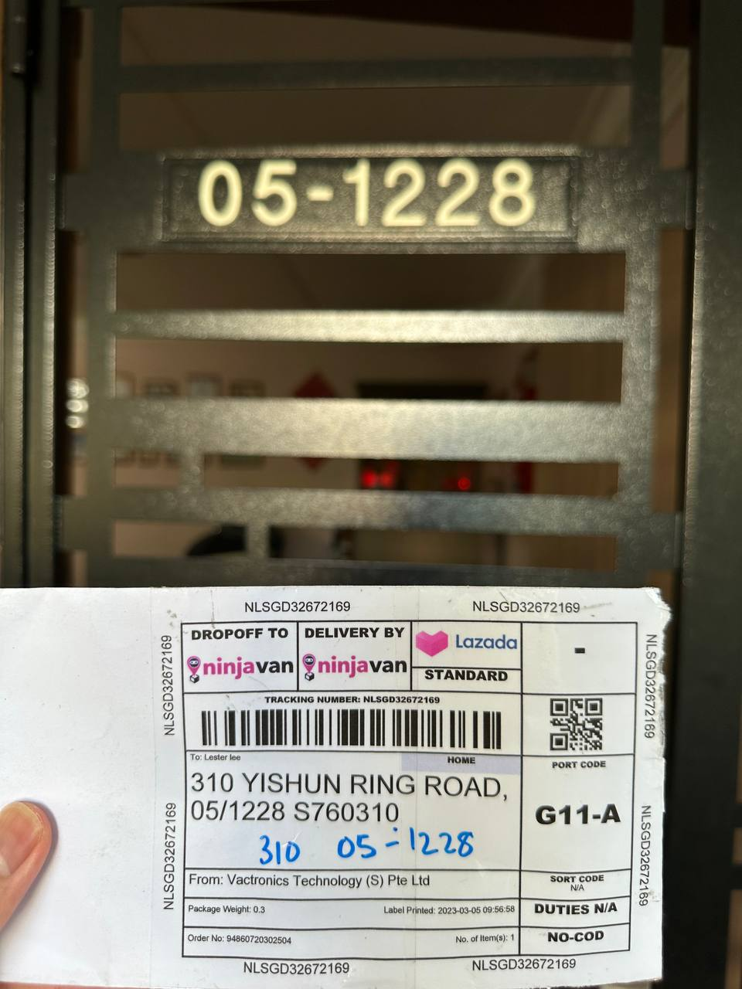
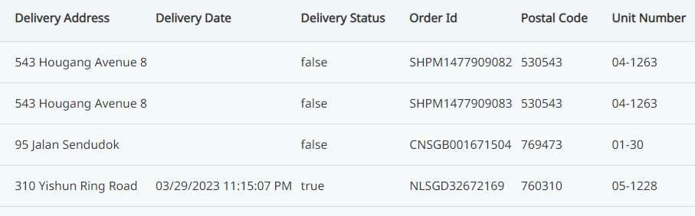
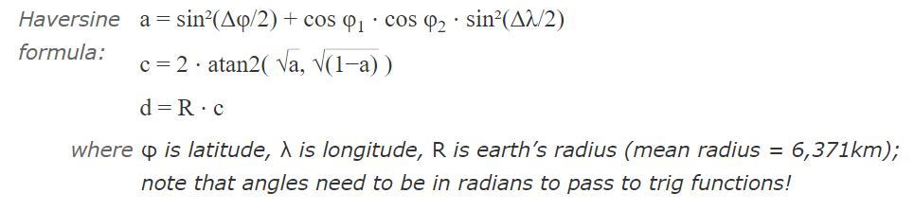
Concept
Computer Vision OCR
Metadata (GPS coordinates)
Bing Maps Location API
Barcode/QR scanner

Slide 9
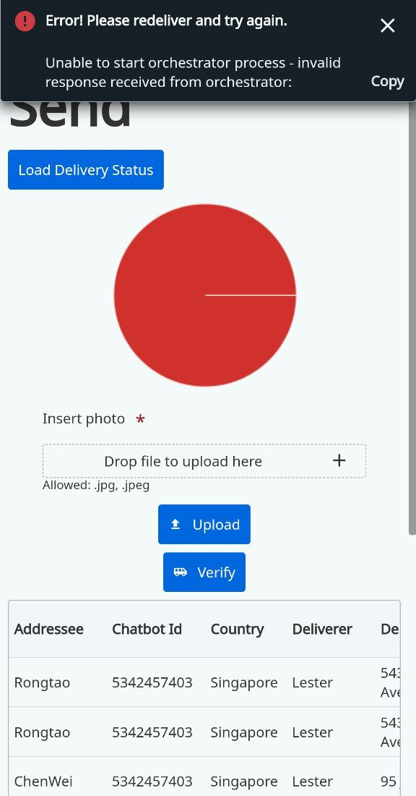
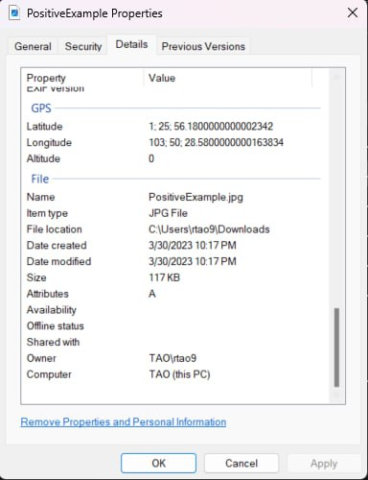
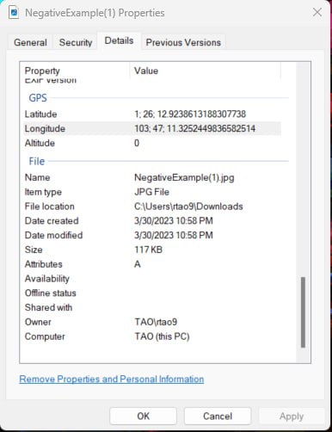
Our Differentiation

Slide 10
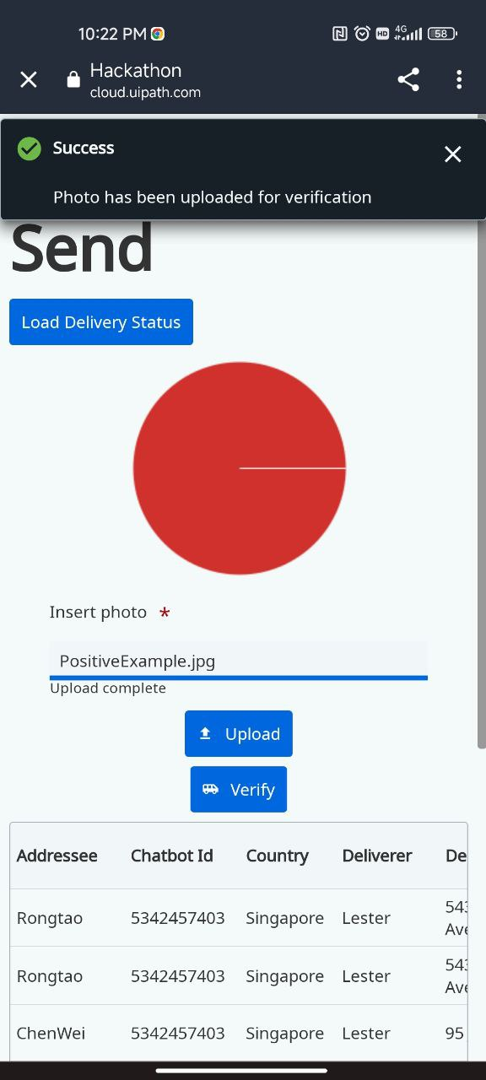
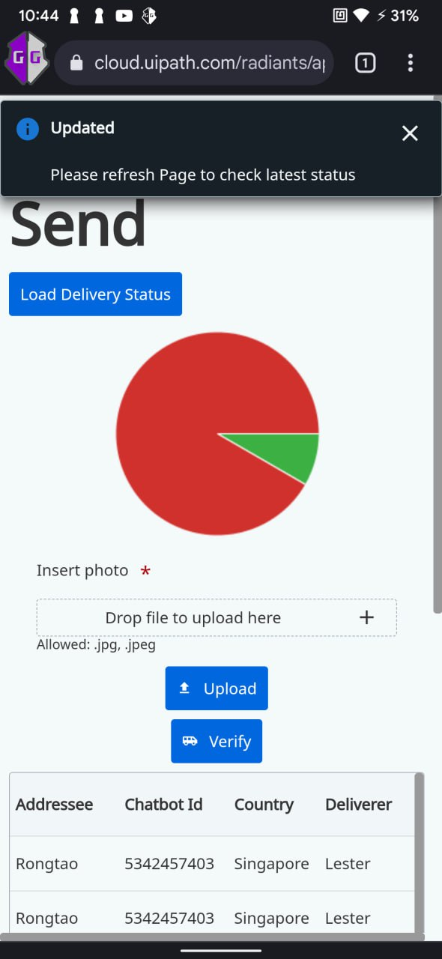
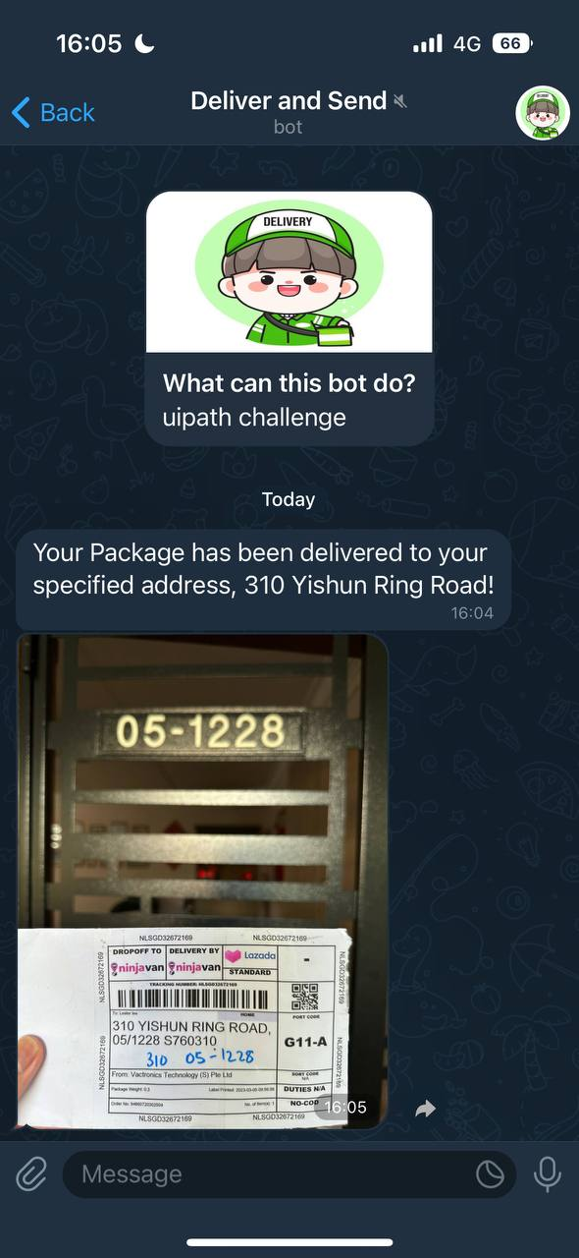
Our Differentiation

Slide 11







Solution Architecture
Delivery Man
Ui Apps
Ui Orchestrator
Unattended Robot
Data services
API
Customer
Upload(Delivery- Image)
POST(Delivery- Image)
Execute(Delivery- Image)
Request(Delivery-Detail)
Return(Delivery-Detail)
Automation (Validation)
Get (API)
API Response
Update(Delivery-Detail)
Acknowledge(Update)
Send notification of successful delivery
Send notification of Wrong Delivery (ALT)

Slide 12







Tools we used
Apps
Data Services

Slide 13
Other Benefits
Statistical analysis can be made on Deliveries that were misdelivered.
Integrate Machine Learning to draw qualitative significance on efficient delivery scheduling.

Slide 14

Scaling The Process
E-Commerce
Our solution is highly scalable as it is deployed onto unattended robot. To further improve the scalability, this solution could be deployed onto serverless robot.
Photo Evidence of delivery of parcel as well as pick up of parcels are logged in our database
Confirmation texts can be sent out in the morning for buyers to confirm their availability on the day of delivery

Slide 15

Other Business Potential
Tourism and Travel
Real Estate
Marketing and Advertising
Security and surveillance
Emergency Services
Car Sharing Services

Slide 16


Thank you for listening!
Don't hesitate to ask any questions!

Slide 17
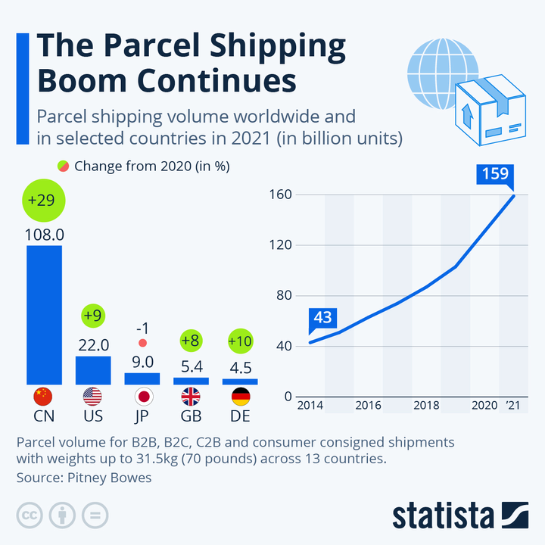
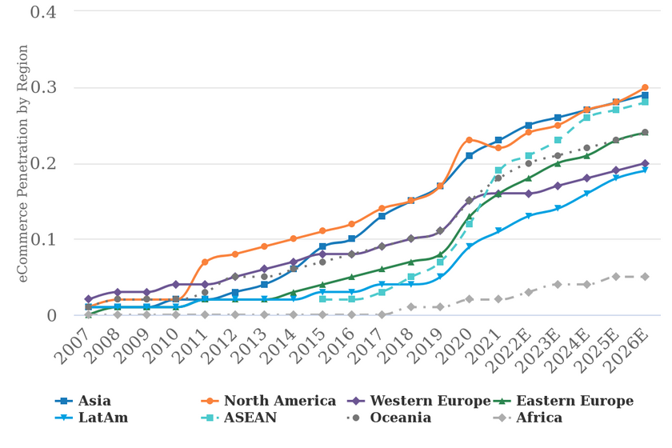
Appendices

Slide 18
Acknowledgemts
https://www.statista.com/chart/10922/parcel-shipping-volume-and-parcel-spend-in-selected-countries/
https://www.mci.gov.sg/pressroom/news-and-stories/pressroom/2020/3/speech-by-mr-s-iswaran-at-the-mci-committee-of-supply-debate-2020-on-3-mar-2020
https://www.statista.com/outlook/dmo/ecommerce/singapore
https://www.morganstanley.com/ideas/global-ecommerce-growth-forecast-2022
https://www.todayonline.com/singapore/missing-parcels-and-delivery-delays-logistics-firms-face-bottlenecks-online-orders-soar

